Slide 1
Statistical Methods for Data Analysis
Probability and PDF’s
Luca Lista
INFN Napoli

Slide 2
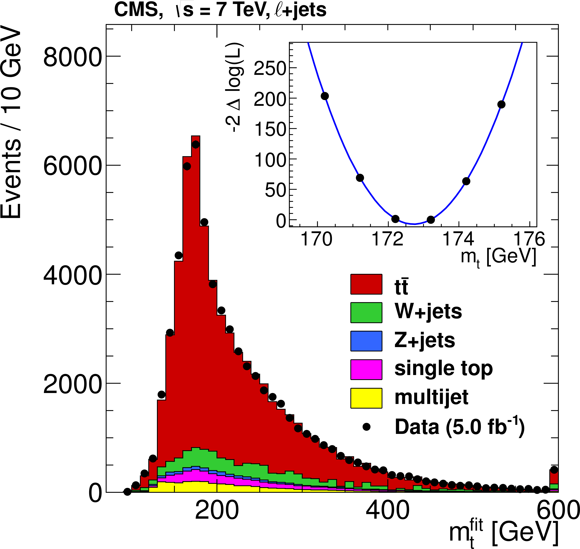
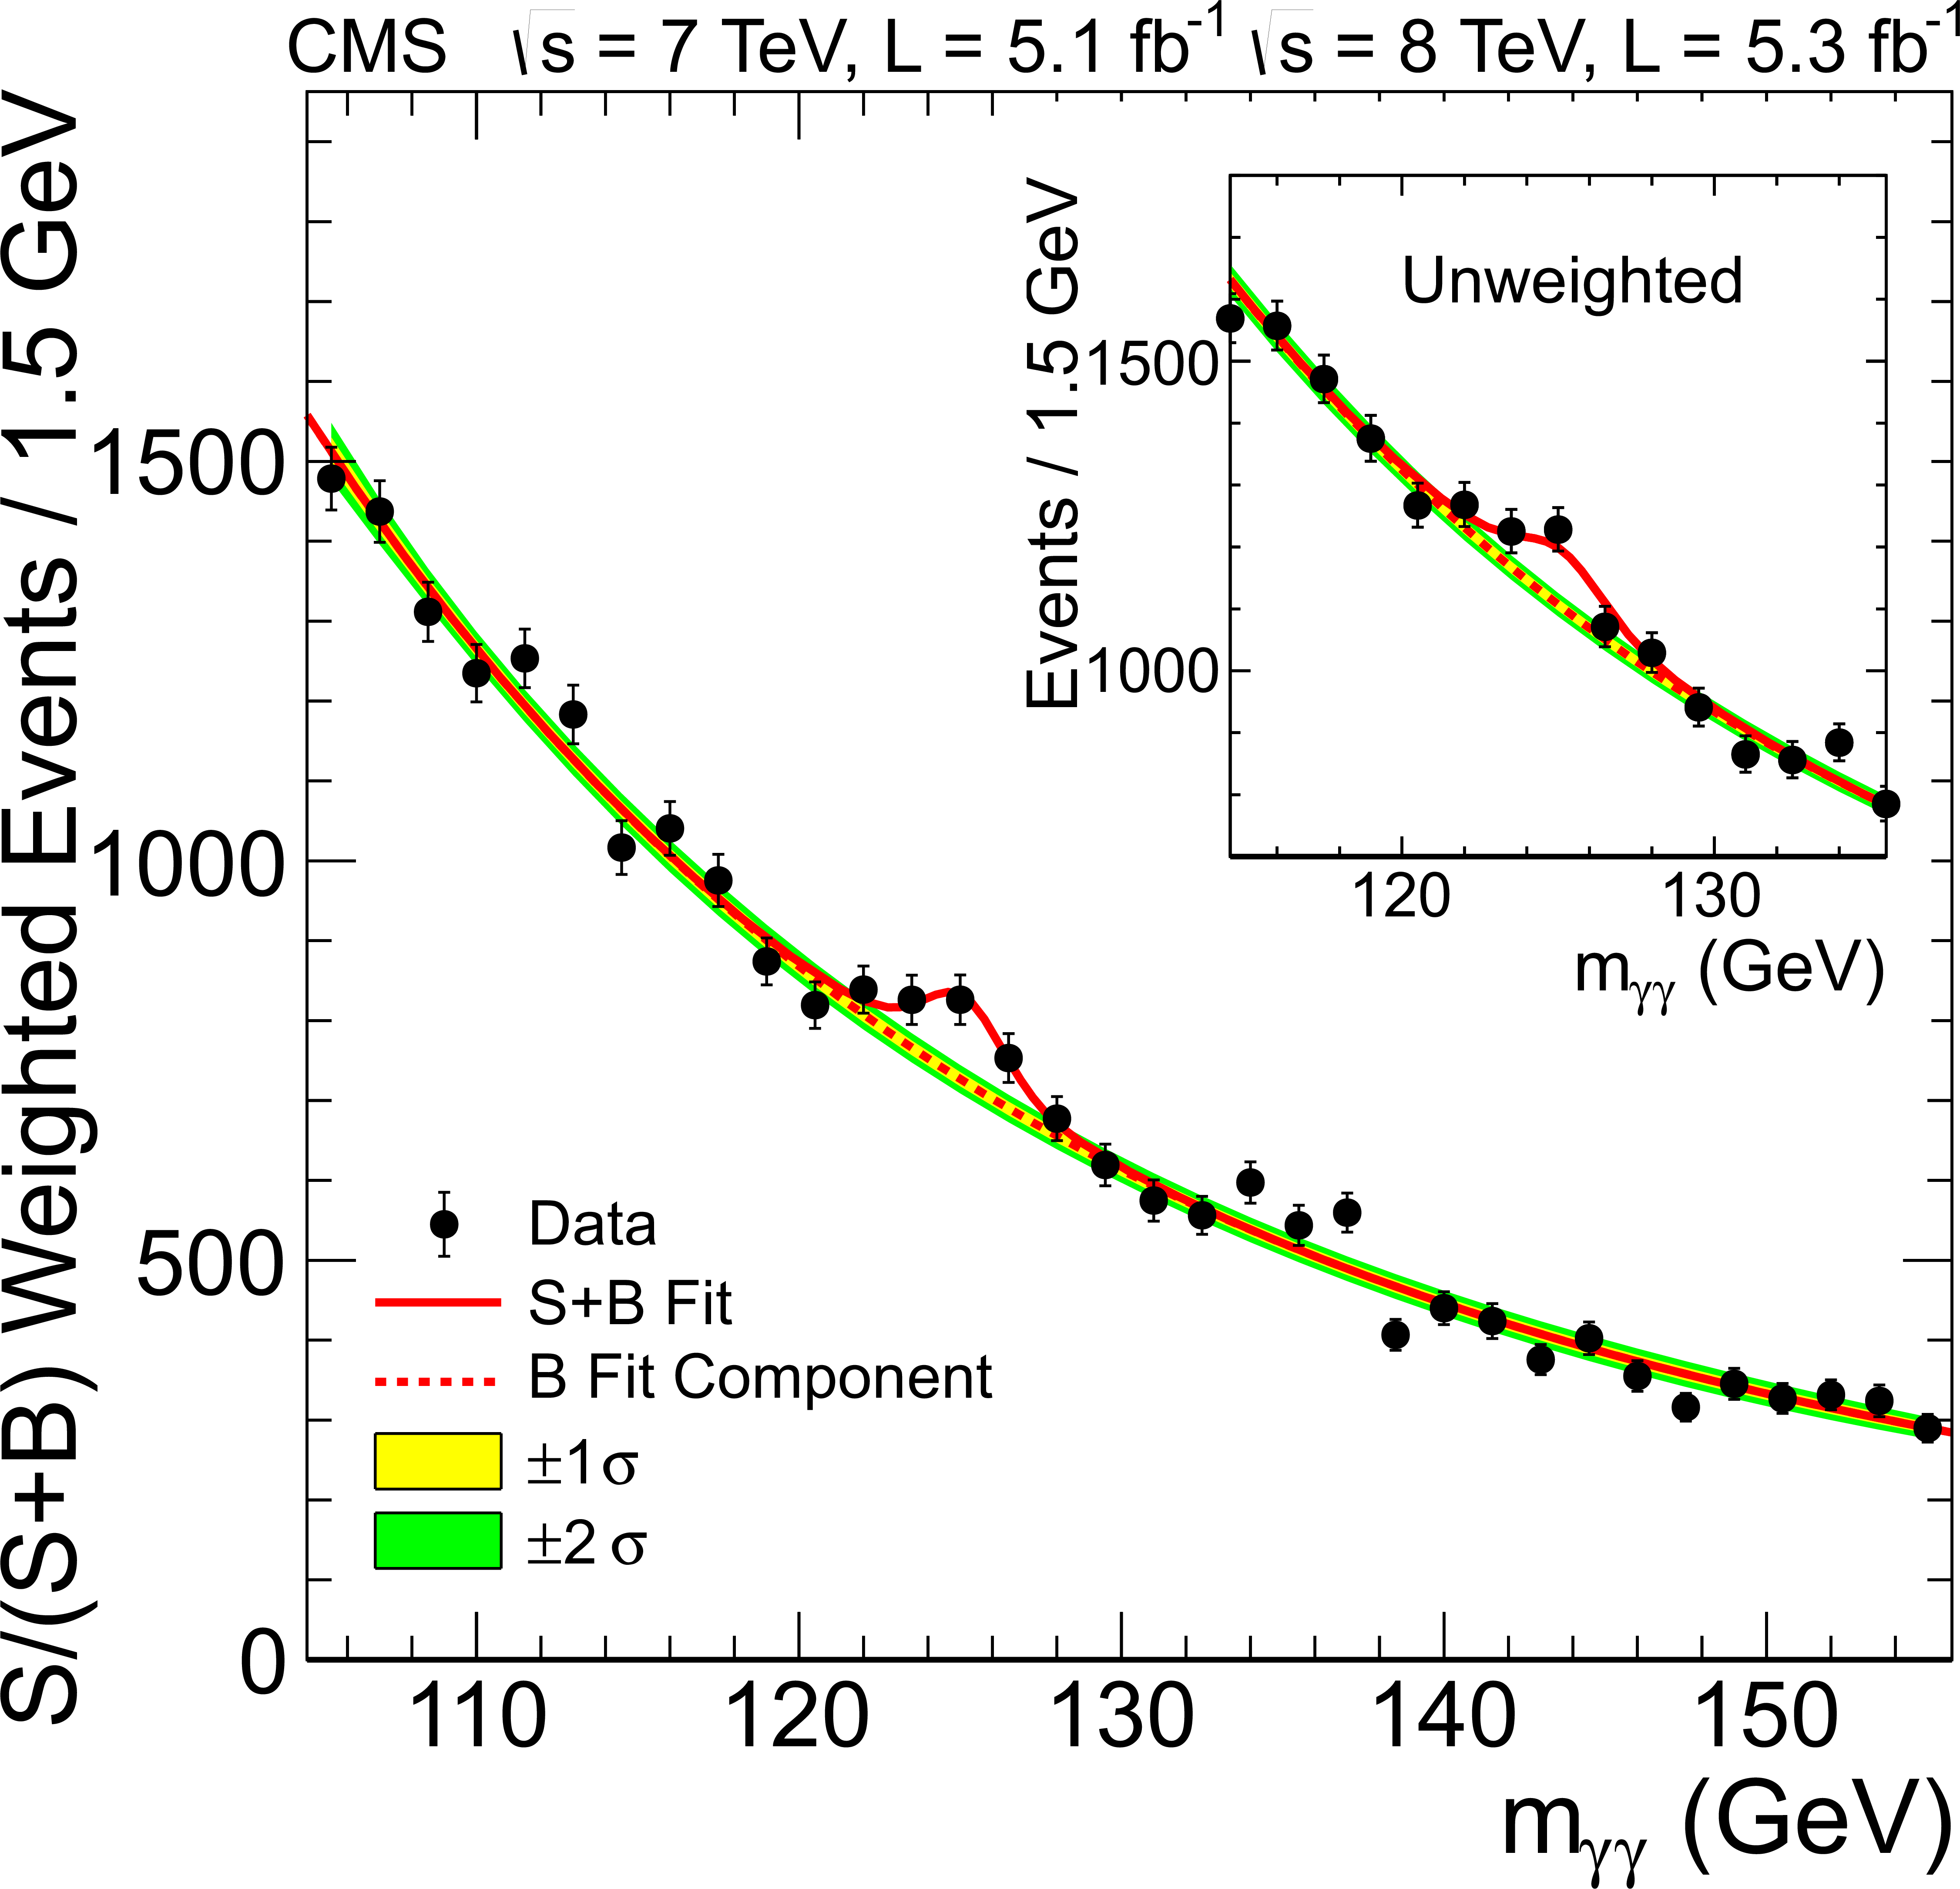
The goals of a physicist
Measurements
Discoveries
m_{t} = 173.49 ± 1.07 GeV
Higgs boson!

Slide 3
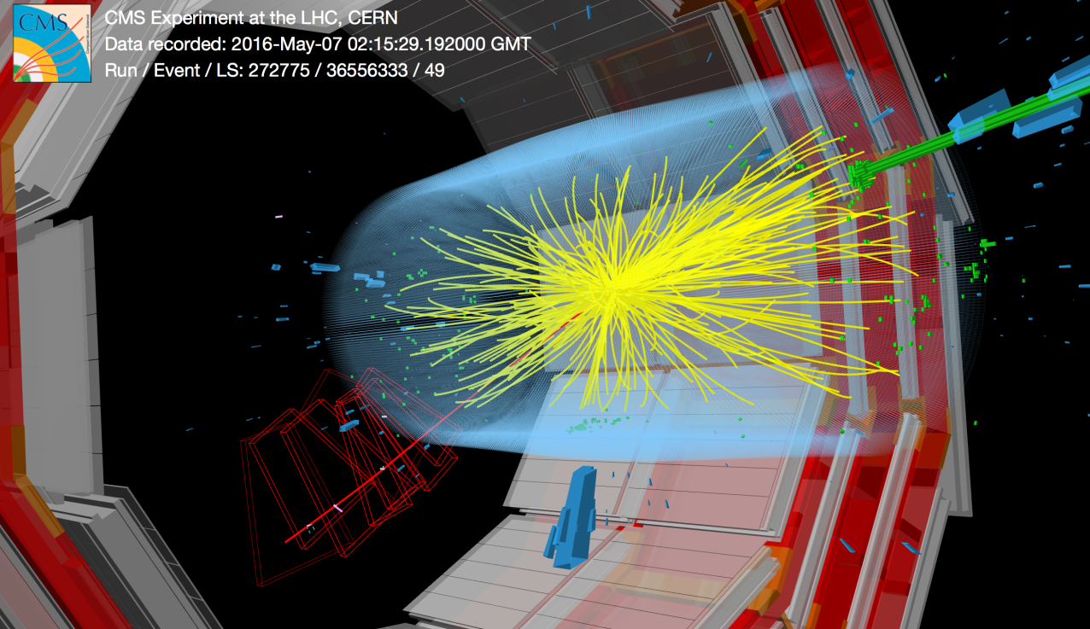
Starting ingredients
Particle collisions are recorded in form of data delivered by detectors
  Measurements of:
  particle position in the
  detector, energy, time, …
Usually a large number of
collision events are collected by an experiment, each event usually containing large amounts of data
Collision event data are all different from each other
  Intrinsic randomness of physics process
  (Quantum Mechanics: P ∝ |A|²)
  Detector response is somewhat random
  (Fluctuations, resolution, efficiency, ….)

Slide 4
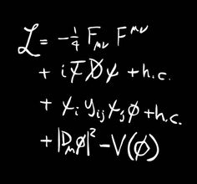
Theory inputs
Distributions of measured quantities
in data:
  are predicted by a theory model,
  depend on some theory parameters,
  e.g.: particle mass, cross section, etc.
Given our data sample, we want to:
  measure theory parameters,
    e.g.: m_{t}= 173.49 ± 1.07 GeV
  answer questions about the nature of data
    Is there a Higgs boson? ➔ Yes! (strong evidence? Quantify!)
    Is there a Dark Matter? ➔ No evidence, so far…
    If not, what is the range of theory parameters compatible with the observed data? What parameter range can we exclude?

Slide 5

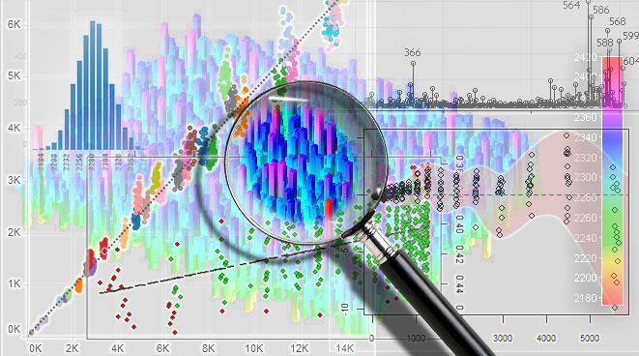

How to proceed
First of all, we need to have probability theory under control, because our data have intrinsic randomness
Then, we should use probability theory on our data and our theory model in order to extract information that will address our questions
I.e.: we use statistics for data analysis
Oscar De Lama, flickr

Slide 6
Introduction to probability
Probability can be defined in different ways
The applicability of each definition depends on the kind of claim we are considering to applying the concept of probability
One subjective approach expresses the degree of belief/credibility of the claim, which may vary from subject to subject
For repeatable experiments, probability may be a measure of how frequently the claim is true

Slide 7
Definition of probability
There are two main different definitions of the concept of probability
Frequentist
  Probability is the ratio of the number of occurrences of an event to the total number of experiments, in the limit of very large number of repeatable experiments.
  Can only be applied to a specific classes of events (repeatable experiments)
  Meaningless to state: “probability that the lightest SuSy particle’s mass is less tha 1 TeV”
Bayesian
  Probability measures someone’s the degree of belief that something is or will be true: would you bet?
  Can be applied to most of unknown events (past, present, future):
    “Probability that Velociraptors hunted in groups”
    “Probability that S.S.C Naples will win next championship”

Slide 8


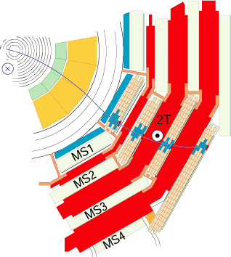
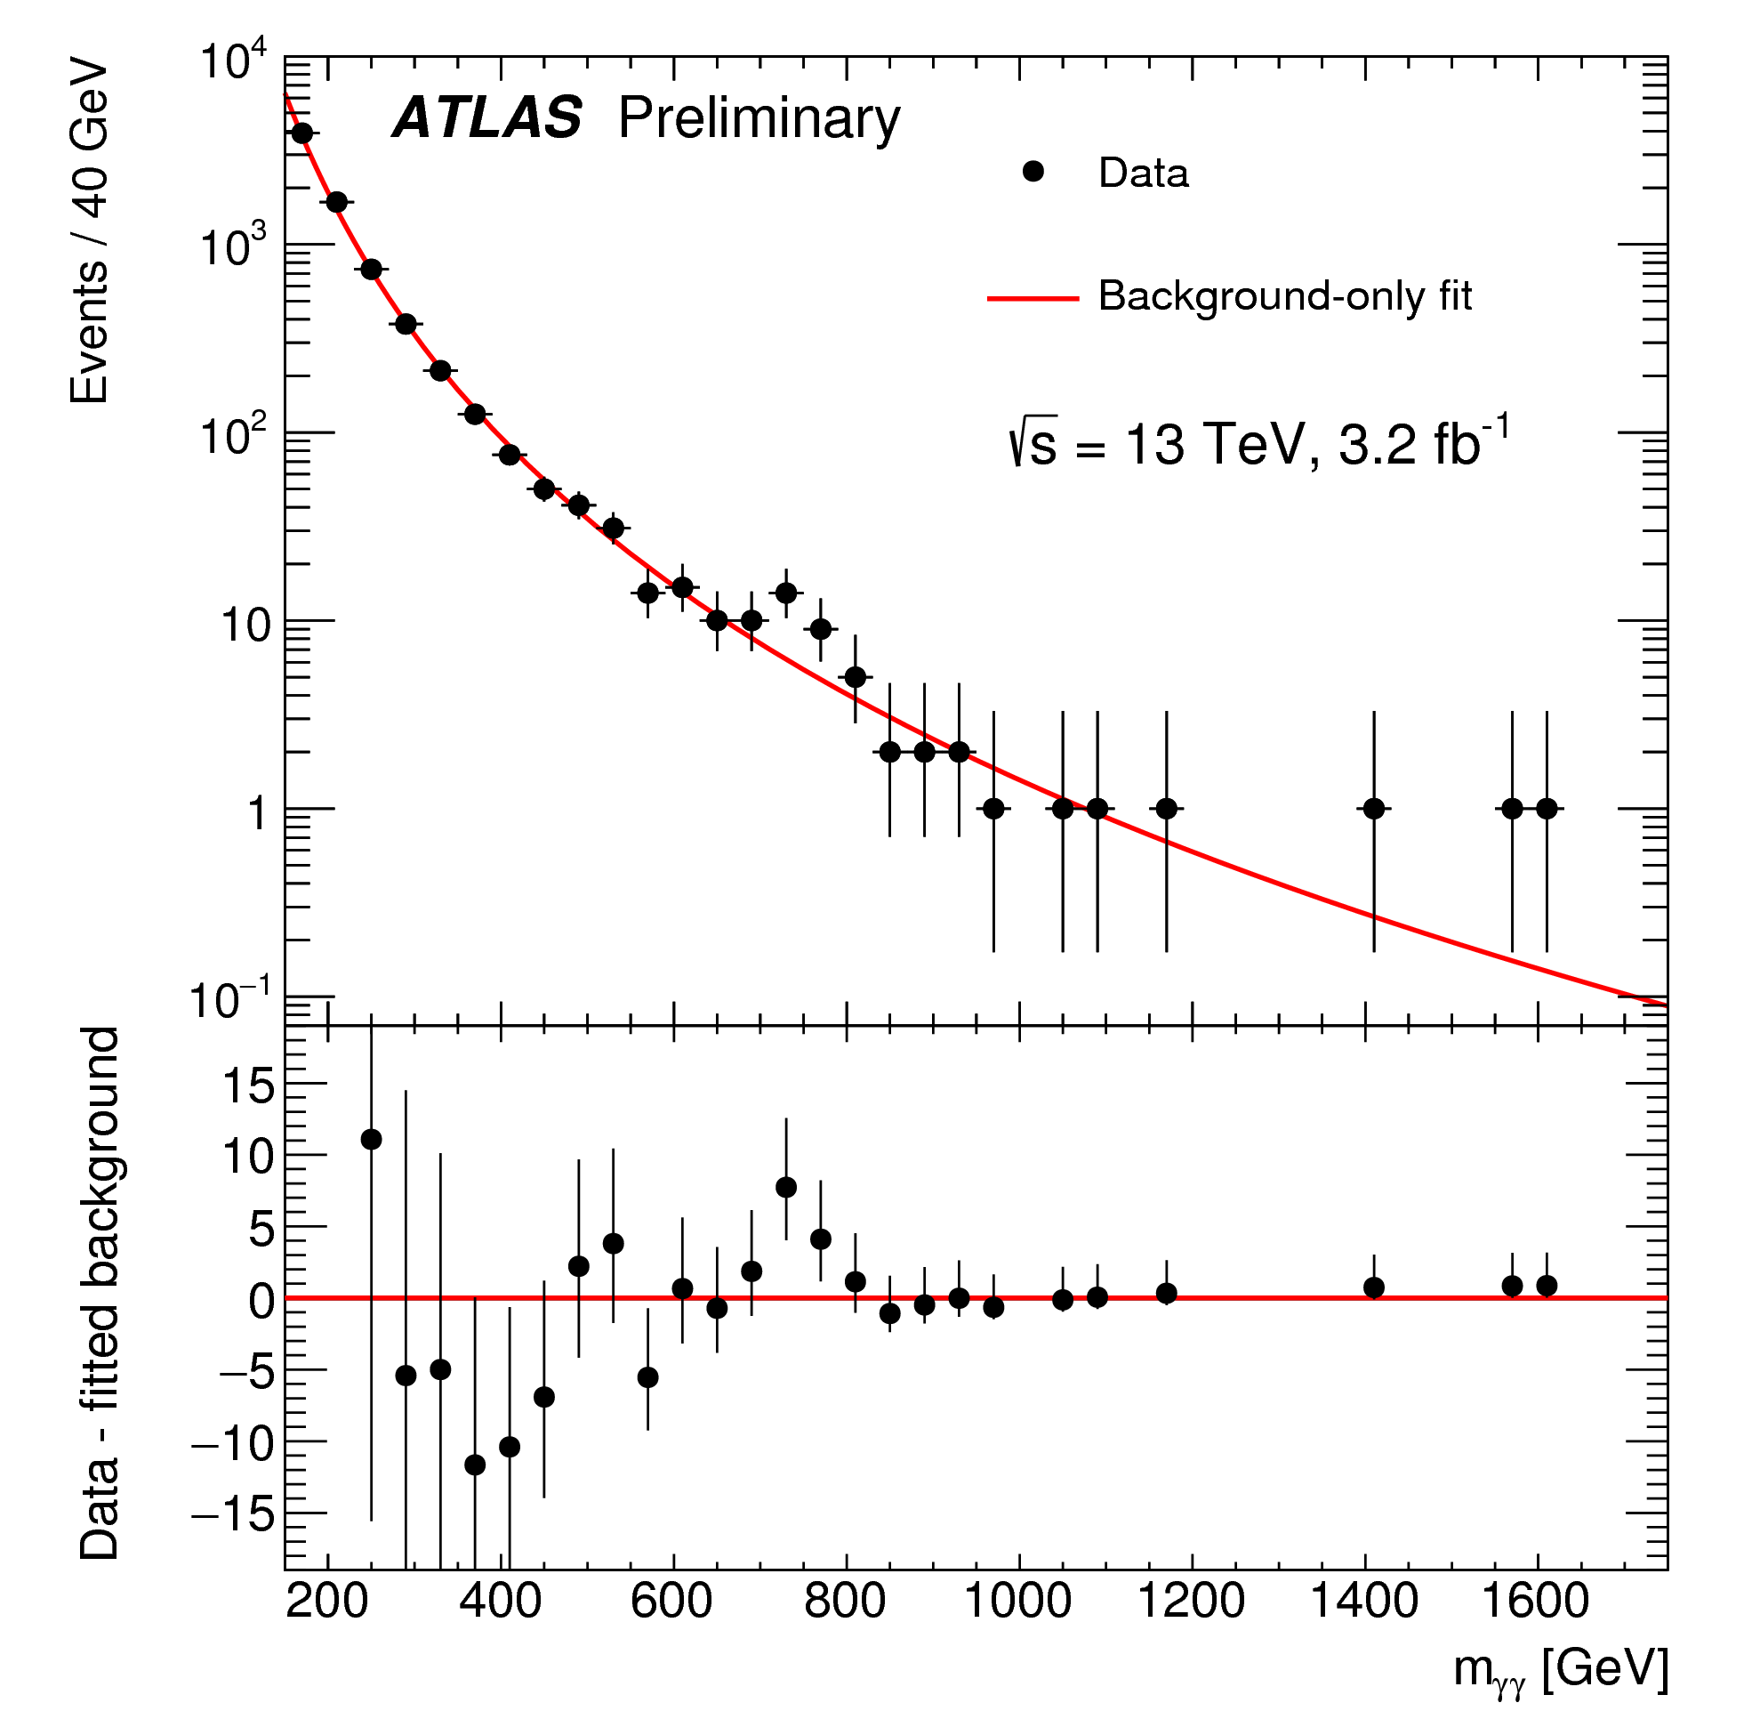
Repeatable experiments
What’s the probability to extract one ace in a deck of cards?
What is the probability to win a lottery
(or bingo, …)?
What is the probability that a pion is incorrectly identified as a muon in CMS?
What is the probability
that a fluctuation in the
background can produce a
peak in the γγ spectrum with a
magnitude at least equal to what
has been observed by ATLAS?
Note: different question w.r.t.: what is the probability that the peak is due to a background fluctuation? (non repeatable!)

Slide 9

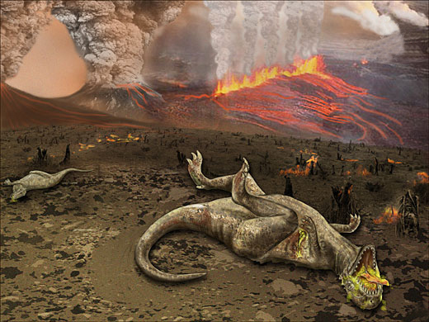
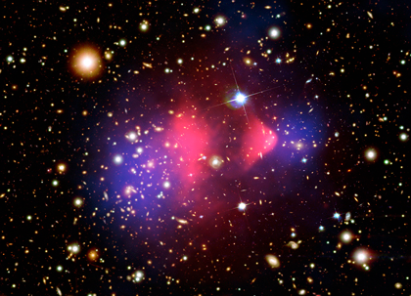

Non repeatable claims
Could be about future events:
  what is the probability that tomorrow it will rain in Geneva?
  what’s the probability that your favorite team will win next championship?
But also past events:
  What’s the probability that dinosaurs went extinct because of an asteroid?
More in general,
it’s about unknown events:
  What is the probability that dark matter is made of particles heavier than 1 TeV?
  What is the probability that climate changes are mainly due to human intervention?

Slide 10
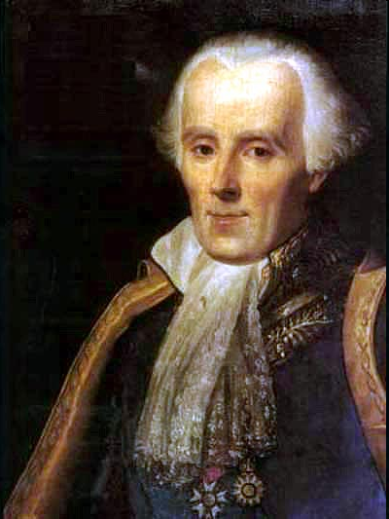
Classical probability
“The theory of chance consists in reducing all the events of the same kind to a certain number of cases equally possible, that is to say, to such as we may be equally undecided about in regard to their existence, and in determining the number of cases favorable to the event whose probability is sought. The ratio of this number to that of all the cases possible is the measure of this probability, which is thus simply a fraction whose numerator is the number of favorable cases and whose denominator is the number of all the cases possible.”
Pierre Simon Laplace
(1749-1827)
Pierre-Simon Laplace,
A Philosophical Essay on Probabilities

Slide 11


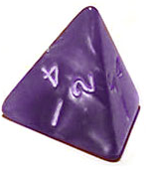
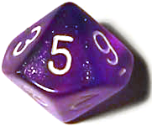
Classical Probability
Assumes all accessible cases are equally probable
This analysis is rigorously valid on discrete cases only
  Problems in continuous cases (→ Bertrand’s paradox)
Number of favorable cases
Probability =
Number of total cases
P = 1/2
P = 1/6
(each dice)
P = 1/4
P = 1/10

Slide 12
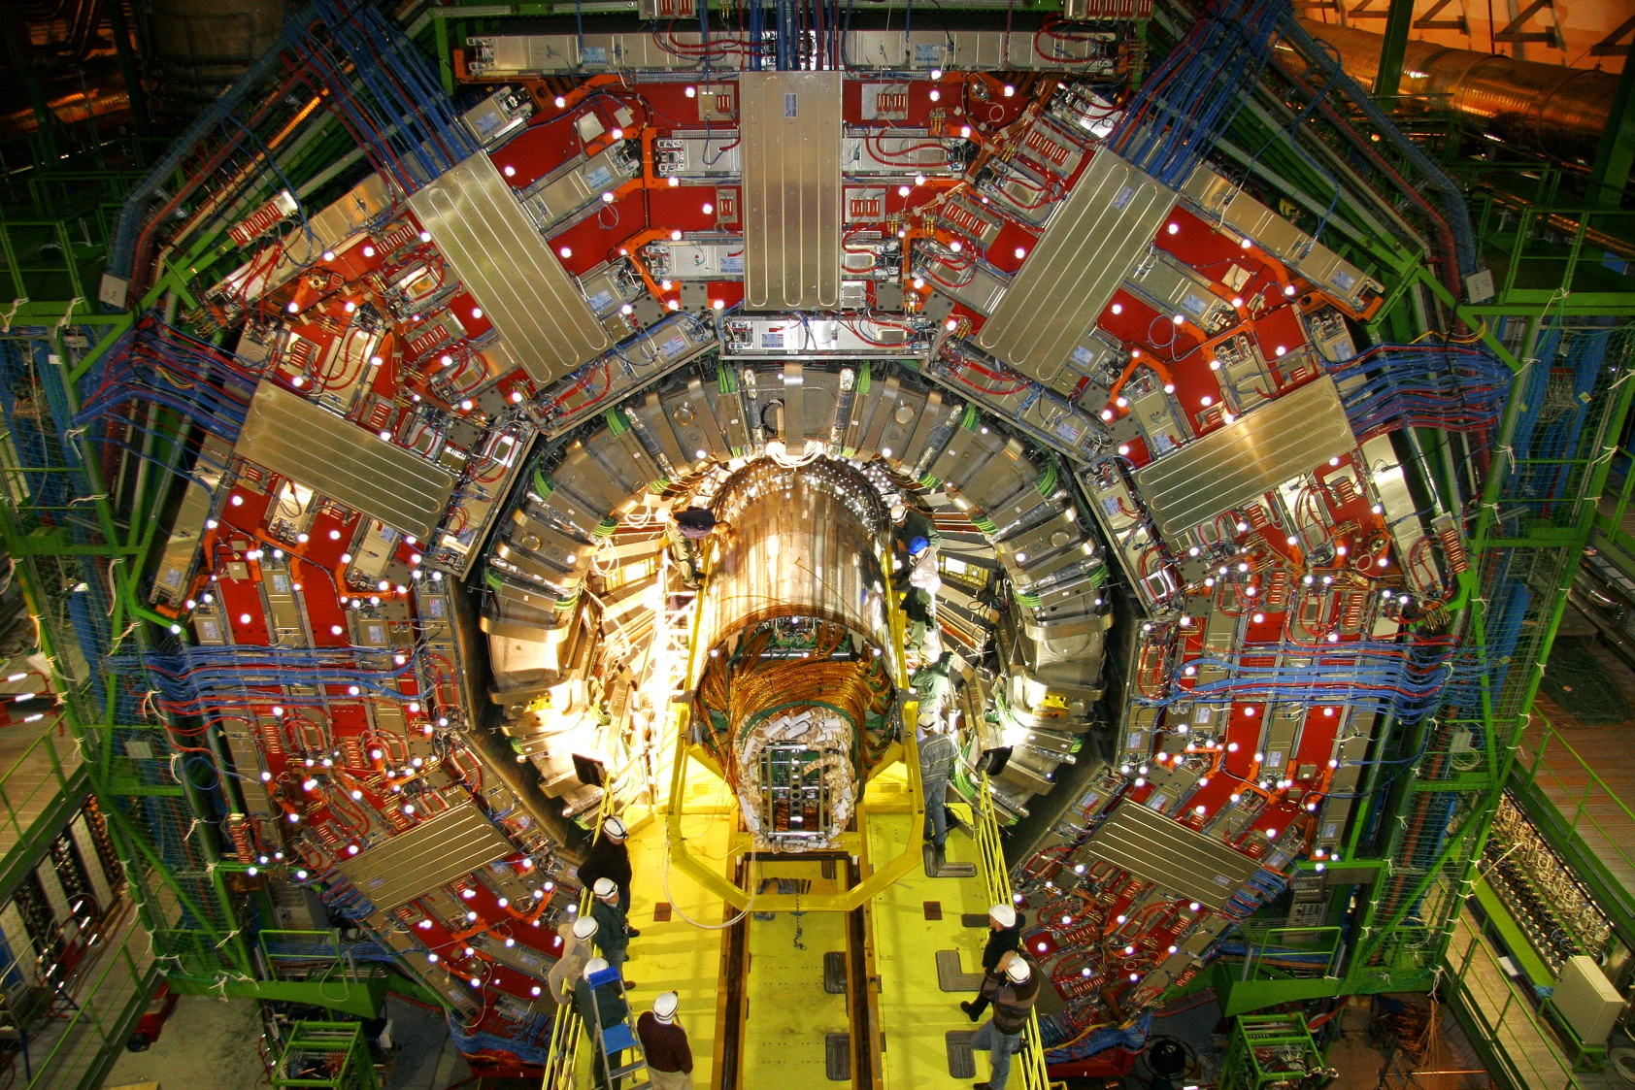
What about something like this?
We should move a bit further…

Slide 13
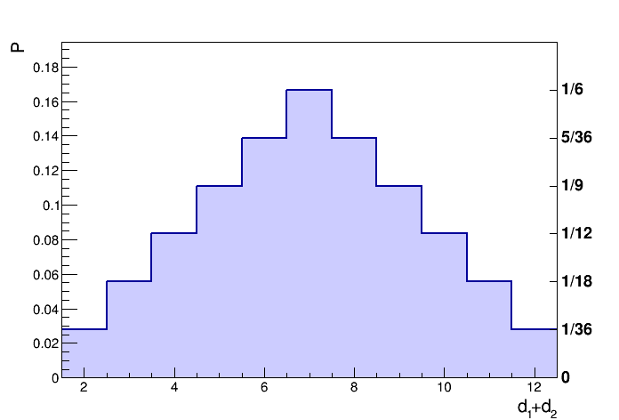
Composite cases
Composite cases are managed via combinatorial analysis
Reduce the (composite) event of interest into elementary equiprobable events (sample space)
Statements about an event can be defined via set algebra
  and/or/not ⇒ intersection/union/complement
  E.g.:
E.g:
2 = {(1,1)}
3 = {(1,2), (2,1)}
4 = {(1,3), (2,2), (3,1)}
5 = {(1,4), (2,3), (3,2), (4,1)}
etc. …
“sum of two dice is even and greater than four”
  {(d₁, d₂): mod(d₁ + d₂, 2) = 0} ∩ {(d₁, d₂): d₁ + d₂ > 4}

Slide 14
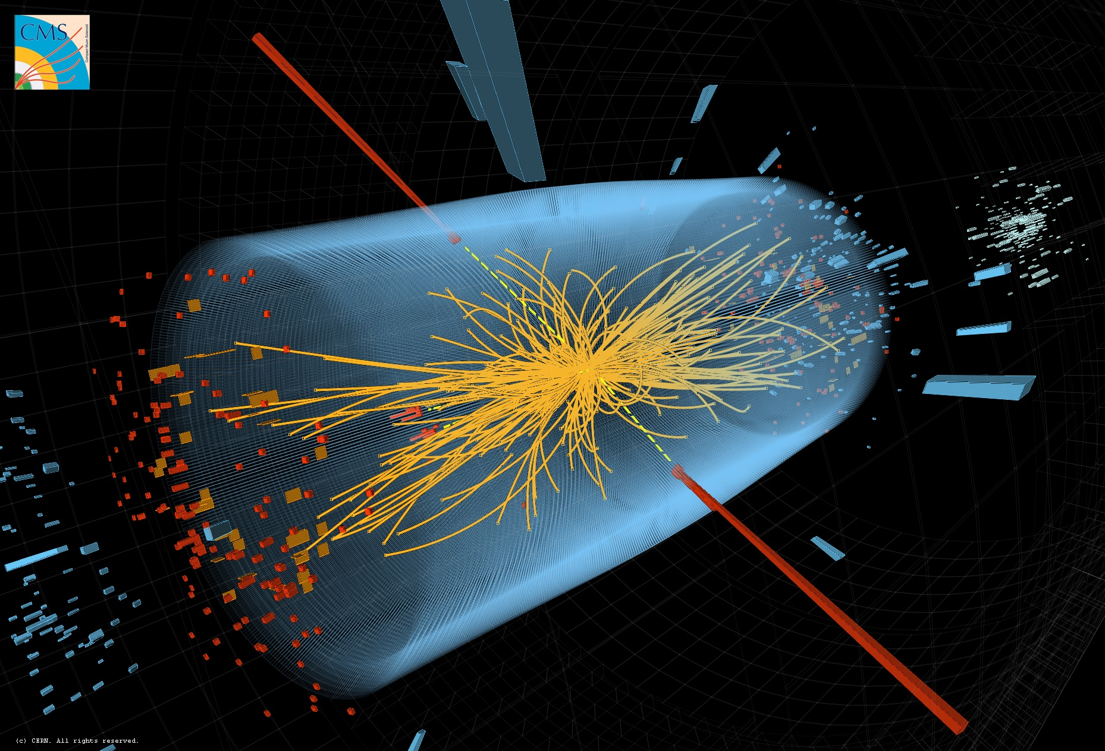
“Event” word overloading
Note that in physics and statistics usually the word “event” have different meanings
Statistics: a subset in the sample space
  E.g.: “the sum of two dice is ≥ 5”
Physics: the result of a collision, as recorded by our experiment
  E.g.: a Higgs to two-photon
  candidate event
In several concrete cases,
an event in statistics may
correspond to many possible
collision events
  E.g.: “p_{T}(γ) > 40 GeV”,
  “The measured m_{H} is > 125 GeV”

Slide 15
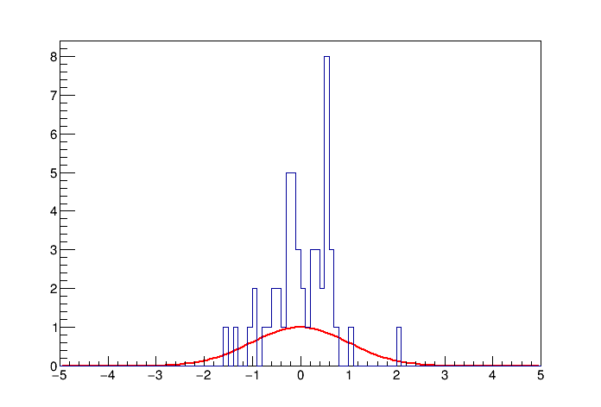
Frequentist probability
Probability P = frequency of occurrence of an event in the limit of very large number (N→∞) of repeated trials
Exactly realizable only with an infinite number of trials
  Conceptually may be
  unpleasant
  Pragmatically acceptable
  by physicists
Only applicable to
repeatable experiments
Number of favorable cases
Probability: P = lim
N→∞
N = Number of trials

Slide 16

Subjective (Bayesian) probability
Expresses one’s degree of belief that a claim is true
  How strong? Would you bet?
  Applicable to all unknown events/claims,
  not only repeatable experiments
  Each individual may have a different
  opinion/prejudice
Quantitative rules exist about how
subjective probability should be modified
after learning about some observation/evidence
  Consistent with Bayes theorem (→ will be introduced in next slides)
  Prior probability → Posterior probability (following observation)
  The more information we receive, the more Bayesian probability is insensitive on prior subjective prejudice
  (unless in pathological cases…)

Slide 17
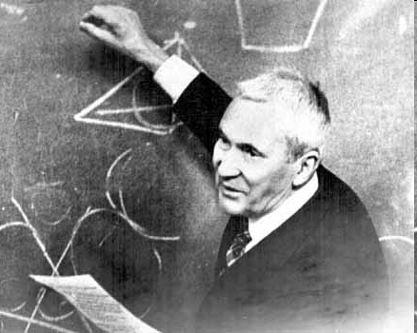


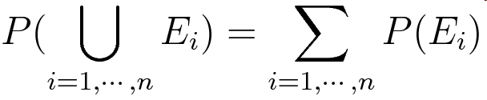
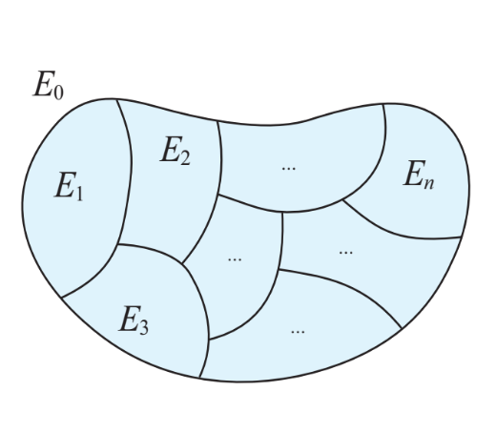
Kolmogorov approach
Axiomatic probability definition
  Terminology: Ω = sample space, F = event
  space, P = probability measure
  Let (Ω, F ⊆ 2^{Ω}, P) be a measure space that
  satisfy:
  1
  2 (normalization)
  3
The same formalism applies to
either frequentist and Bayesian
probability
Andrej Nikolaevič Kolmogorov
(1903-1987)
Ω

Slide 18
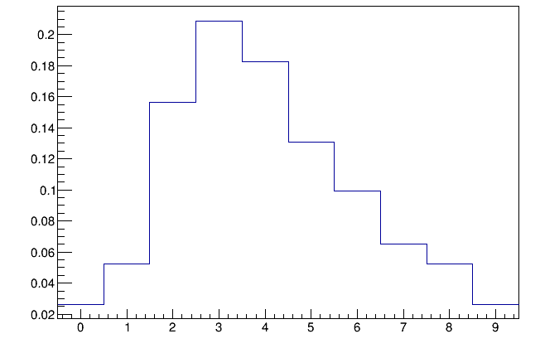

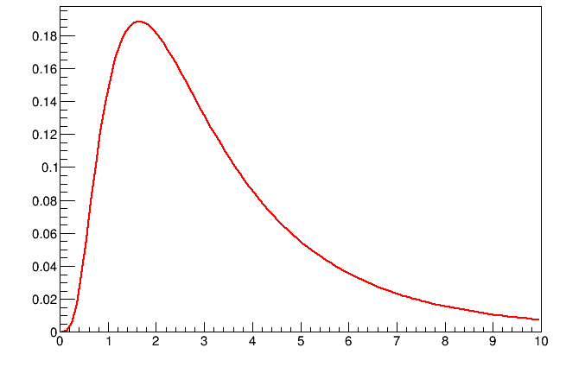
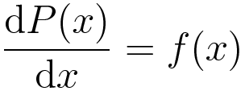
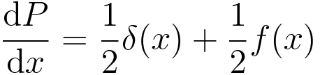
Probability distributions
Given a discrete random variable, we can
assign a probability to each individual value:
In case of a continuous variable, the probability
assigned to an individual value may be zero
A probability density better quantifies the
probability content (unlike P({x}) = 0 !):
Discrete and continuous distributions can be
combined using Dirac’s delta functions.
E.g.:
50% prob. to have zero (P({0}) = 0.5), 50% distributed according to f(x)
P
n
f(x)
x

Slide 19
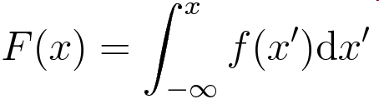
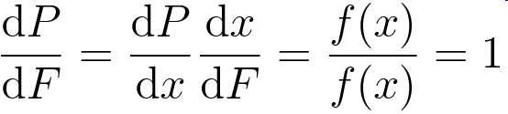
Cumulative distribution
Given a PDF f(x), the cumulative is defined as:
The PDF for F is uniformly distributed in [0, 1]:

Slide 20
Bertrand’s paradox
Given a randomly chosen chord on a circle, what is the probability that the chord’s length is larger than the side of the inscribed triangle?
“Randomly chosen” is not a well defined concept in this case
Some classical probability concepts become arbitrary until we move to PDF’s (uniform in which ‘metrics’?)
P = 1/2
P = 1/3
P = 1/4

Slide 21
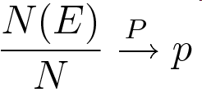

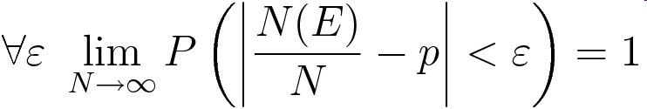
Probability definition (freqentist)
A bit more formal definition of probability:
Law of large numbers:
if
i.e.:
… isn’t it a circular definition?
Notes:
\forall\varepsilon\,\,\lim_{N\rightarrow\infty}P\left(\left|\frac{N(E)}{N}-p\right|<\varepsilon\right) = 1

Slide 22
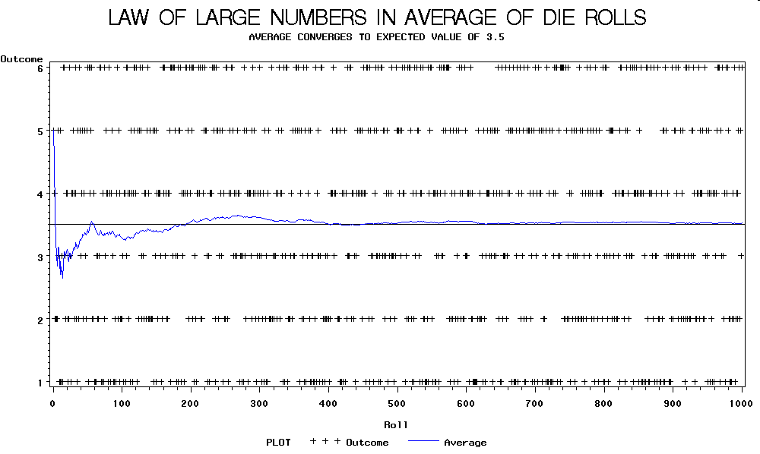
In a picture…

Slide 23
Problems with frequentist probability
Frequentist probability is, to some extent, circularly defined
  A phenomenon can be proven to be random (i.e.: obeying laws of statistics) only if we observe infinite cases
  F.James et al.: “this definition is not very appealing to a mathematician, since it is based on experimentation, and, in fact, implies unrealizable experiments
  (N→ ∞)”. But a physicist can take this with some pragmatism
  A frequentist model can be justified by details of poorly predictable underlying physical phenomena
    Deterministic dynamic with instability (chaos theory, …)
    Quantum Mechanics is intrinsically probabilistic…!
  A school of statisticians state that Bayesian statistics is a more natural and fundamental concept, and frequentist statistic is just a special sub-case
Notes:
\forall\varepsilon\,\,\lim_{N\rightarrow\infty}P\left(\left|\frac{N(E)}{N}-p\right|<\varepsilon\right) = 1

Slide 24
Problems with subjective probability
On the other hand, Bayesian approach is subjectivity by definition, which is unpleasant for scientific applications.
  Bayesian reply that it is actually inter-subjective, i.e.: the real essence of learning and knowing physical laws…
Frequentist approach is preferred by the large fraction of physicists (probably the majority, but Bayesian statistics is getting more and more popular in many application, also thanks to its easier application in many cases)
Notes:
\forall\varepsilon\,\,\lim_{N\rightarrow\infty}P\left(\left|\frac{N(E)}{N}-p\right|<\varepsilon\right) = 1

Slide 25
Conditional probability
Probability of A, given B: P(A | B)
i.e.: probability that an event known to belong to set B, is also a member of set A:
  P(A | B) = P(A ∩ B) / P(B)
Event A is said to be
independent on B if the
conditional probability of
A given B is equal to the
probability of A:
  P(A | B) = P(A)
Hence, if A is independent on B:
  P(A ∩ B) = P(A) P(B)
→ If A is independent on B, B is independent on A
A
B

Slide 26


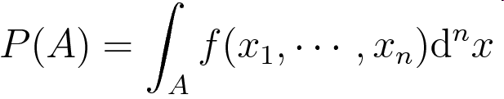
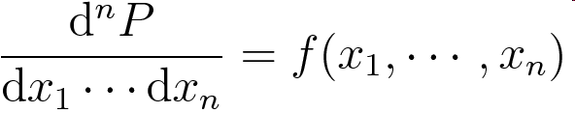
Prob. Density Functions (PDF)
Sample space = { }
Experiment = one point on the sample space
Event = a subset A of the sample space
P.D.F. =
Probability of an event A =
Differential probability:
For continuous cases, the probability of an event made of a single experiment is zero: P({x₀}) = 0
Discrete variables may be treated as “Dirac’s δ”
  uniform treatment of continuous and discrete cases

Slide 27
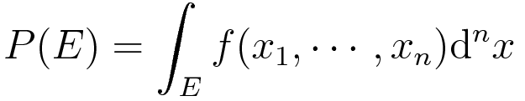
PDFs in more dimensions
In more dimensions (n random variables), PDF can be defined as:
The probability associated to an event E is obtained by integrating the PDF over the
corresponding set in the sample
space
Ω
E

Slide 28
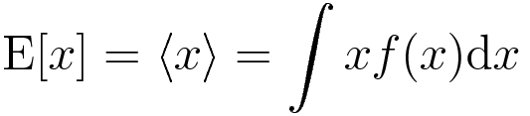
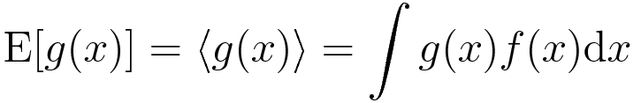
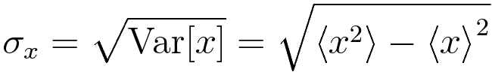
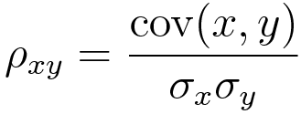
Mean and variance of random vars.
Given a random variable x with distribution f(x) we can define:
Mean or
expected value:
Variance:
Standard deviation:
Covariance and correlation coefficient of two variables x and y:
r.m.s.: root mean square
Note: integration extends over x and y in two dimensions when computing an average value!

Slide 29
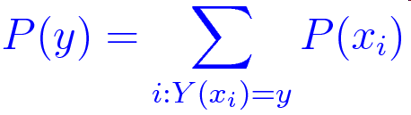
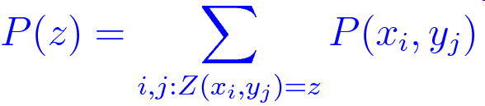
Variables transformation (discrete)
1D case: y = Y(x)
{x₁, …, x_{n}} → {y₁, …, y_{m}} = {Y(x₁), …, Y(x_{n})}
  Note that different Y(x_{n}) may coincide (n ≠ m)!
So:
Generalization to more variables is straightforward:
Sum on all cases which give the right combination (z)
Will see how to generalize to the continuous case and get the error propagation!

Slide 30
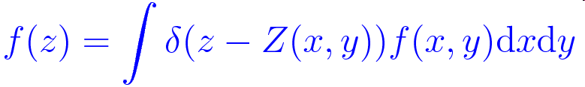
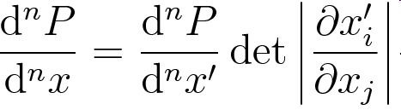
Coordinate transformation
From 2D to 1D:
Generic change of coordinate (2D):
Generalization of discrete case: sum only on elementary events (experiments) where:
  x′_{i} = X′_{i}(x₁, x₂) (e.g.: result of sum of two dices)
Easy to implement with Monte Carlo
If the relation is invertible, the Jacobian determinant has to be multiplied by the transformed PDF
  Replace (x, y) in f with inverse transformation
  Transform of the n-D volume with jacobian:
Notes:
\frac{\mathrm{d}^nP}{\mathrm{d}^nx} = \frac{\mathrm{d}^nP}{\mathrm{d}^nx^\prime}\det\left|\frac{\partial x^\prime_i}{\partial{x}_j}\right|
f^\prime(x_1^\prime,x_2^\prime) = \int \delta(x_1^\prime - X_1^\prime(x_1, x_2))\delta(x_2^\prime - X_2^\prime(x_1, x_2))f(x_1,x_2)\mathrm{d}x_1\mathrm{d}x_2

Slide 31
PDF Examples

Slide 32
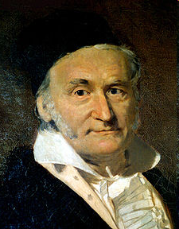
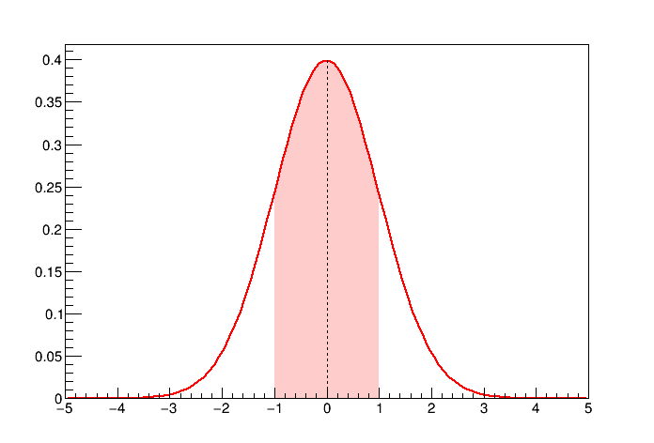
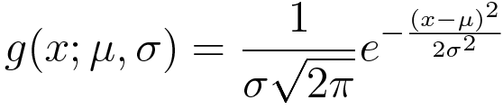
Gaussian distribution
Many random variables in real experiments follow a Gaussian distribution
Central limit theorem: approximate sum of multiple random contributions, regardless of the individual distributions
Frequently used to model detector resolution
Carl Friedrich Gauss
(1777-1855)
g
p = 68.3%
nσ | Prob.
1 | 0.683
2 | 0.954
3 | 0.997
4 | 1 – 6.3×10⁻⁵
5 | 1 – 5.7×10⁻⁷
p = 15.8%
σ
σ
p = 15.8%
x

Slide 33
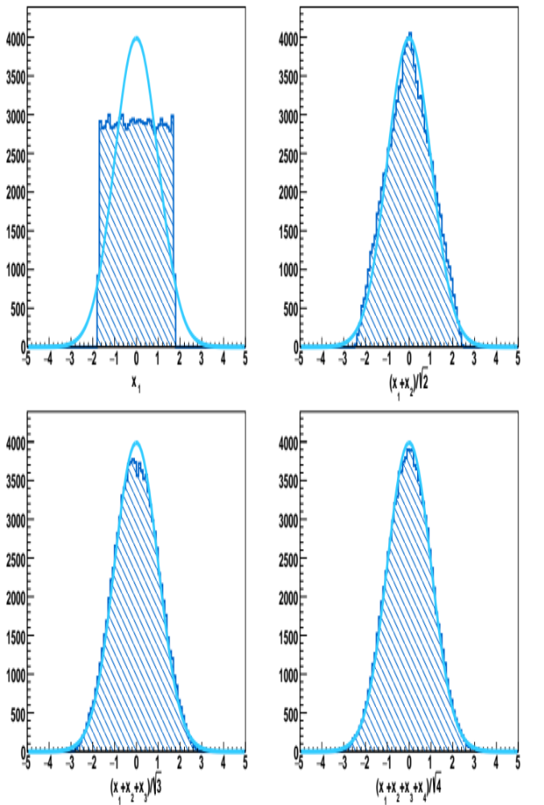
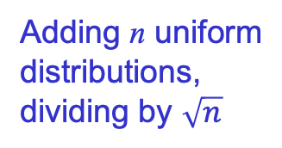
Central limit theorem
The average of N random variables R_{n} converges to a Gaussian, irrespective to the original distributions
Adding n uniform
distributions,
dividing by $\sqrt{n}$
Basic regularity conditions
must hold
(incl. finite variance)

Slide 34
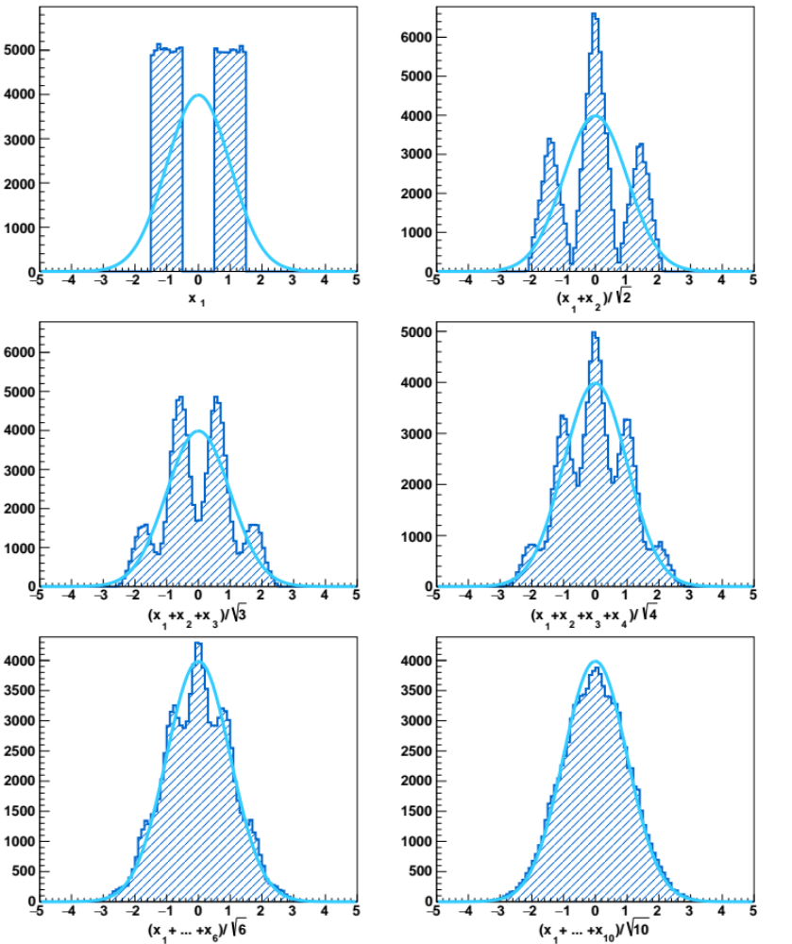
Central limit theorem

Slide 35
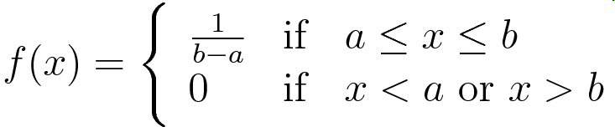
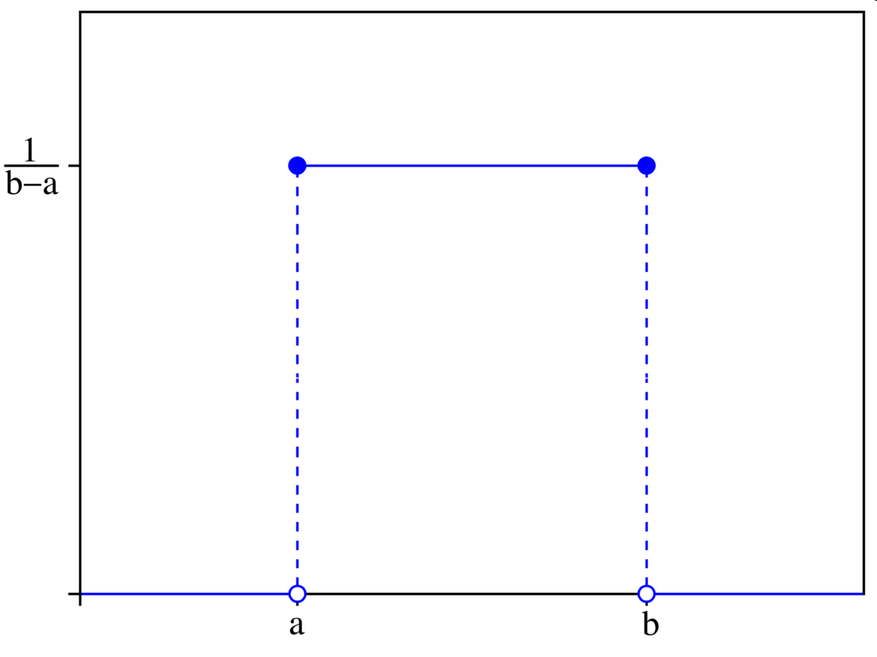
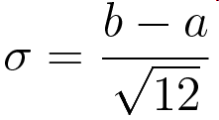
Uniform (“flat”) distribution
Std. deviation=
Model for position of rain drops, time of cosmic ray passage, etc.
Basic distribution for pseudo-random number generators
Notes:
f(x) = \Biggl\{ \begin{array}{lcl} \frac{1}{b-a} &\mathrm{if}& a \le x \le b \\ 0 &\mathrm{if} & x < a \,\, \mathrm{or}\,\, x > b \end{array}
\sigma = \frac{b - a}{\sqrt{12}}

Slide 36


Distance from a time t₀ to first ‘count’
t₀ is an arbitrary time
Also: t = time between t₀ and the first count
t₀ = 0
t₁
Neglect the probability
that two or more occur, O(δt²)
t
Notation: P(n,[t₁, t₂]) = probability of
n entries in [t₁, t₂] given a rate r
δt
Independent events
Equivalently:

Slide 37



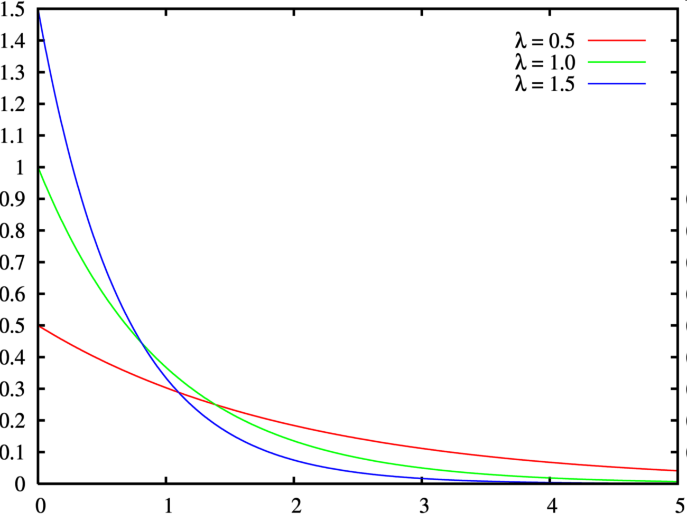
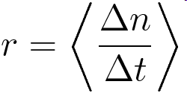



Exponential distribution
Cumulative
r = 0.5
r = 1.0
r = 1.5

Slide 38





Binomial distribution
Probability to extract n red balls over N trials, given the fraction p of red balls in a basket
Red: p = 3/10
White: 1 – p = 7/10
Typical application in physics:
detector efficiency (ε = p)
p = 3/10

Slide 39

Multiple random extractions
Extraction path leads to
Pascal’s / Tartaglia’s triangle
like (a + b)^{n}
1
p
1
p
1 − p
1
4
p
p
1 − p
3
p
1
p
1 − p
2
1 − p
6
p
p
1 − p
1
1 − p
3
p
1 − p
1
1 − p
4
p
1 − p
1
1 − p
1
Notes:
\left( {\begin{array}{*{20}c}
n \\
k \\
\end{array}} \right) = \frac{{n!}}{{k!\left( {n - k} \right)!}}

Slide 40

Binomial distribution
Distribution of number of “successes” on N trials, each trial with “success” probability p
Average: ⟨n⟩ = Np
Variance: ⟨n²⟩ − ⟨n⟩² = Np(1−p)
Frequently used for
efficiency estimate
  Efficiency error σ = Var(n)^{½} :
Note: σ_{ε} = 0 for ε = 0, 1

Slide 41



Tartaglia or Pascal?
India: 10th century commentaries of Chandas Shastra Pingala, dating 5th-2nd century BC
Persia: Al-Karaji (953–1029),
Omar Khayyám ( , 1048-1131): “Khayyam triangle”
China: Yang Hui ( , 1238-1298):
“Yang Hui triangle”
Germany: Petrus Apianus (1495-1552)
Italy: Niccolò Fontana Tartaglia
(Ars Magna, by Gerolamo Cardano, 1545): “Triangolo di Tartaglia”
France: Blaise Pascal (Traité du triangle arithmétique, 1655)

Slide 42



Poisson distribution
Distribution of the number of occurrences of random event uniformly distributed in a measurement range whose rate is known
  E.g.: number of rain drops in a given area and in a given time interval, number of cosmic rays
  crossing a
  detector in a
  given time
  interval
P
ν = 2
Siméon-Denis Poisson
(1781-1840)
ν = 5
ν = 10
Can be approximated with a Gaussian distribution for large values of ν.
ν = 20
ν = 30
n

Slide 43




Origin of Poisson distribution
x
X >> x
r = ⟨N / X⟩,
N, X → ∞
Probability to have n entries in x
  Expect on average ν = N x / X = r x
  Binomial, where p = x / X = ν / N << 1
Notes:
P(n; \nu, N) = \frac{N!}{n!(N-n)!}\left(\frac{\nu}{N}\right)^n \left(1-\frac{\nu}{N}\right)^{N-n}
=\frac{\nu^n}{n!} \frac{N(N-1)\cdots (N-n+1)}{N^n}\left(1-\frac{\nu}{N}\right)^N\left(1-\frac{\nu}{N}\right)^{-n}

Slide 44
Summing Poissonian variables
Probability distribution of the sum of two Poissonian variables with expected values ν₁ and ν₂:
  P(n) = Σ_{m=0}^{n} Poiss(m; ν₁) Poiss(n – m; ν₂)
The result is still a Poissonian:
  P(n) = Poiss(n; ν₁ + ν₂)
Useful when combining Poissonian signal plus background:
  P(n; s, b) = Poiss(n; s + b)
The same holds for ‘convolution’ of binomial and Poissonian
  Take a fraction of Poissonian events with binomial ‘efficiency’
No surprise, given how we constructed Poissonian probability!

Slide 45








Demonstration: Poisson ⊗ Binomial
⊗
Notes:
P(s_0;\mu) = \frac{e^{-\mu}\mu^{s_0}}{s_0!}
B(s; s_0, \varepsilon) = \frac{s_0!}{s!(s_0 - s)!} \varepsilon^s(1-\varepsilon)^{s_0-s}
P(s; \mu, \varepsilon) = \sum_{s_0 = s}^{\infty}P(s_0;\mu)B(s; s_0, \varepsilon)
= \sum_{s_0 = s}^{\infty}\frac{e^{-\mu}\mu^{s_0}}{s_0!} \cdot \frac{s_0!}{s!(s_0-s)!}\varepsilon^s(1-\varepsilon)^{s_0-s}
= \frac{e^{-\mu}(\varepsilon\mu)^s}{s!} \sum_{s_0 = s}^{\infty}\frac{\mu^{s_0 -s}(1-\varepsilon)^{s_0-s}}{(s_0-s)!}
= \frac{e^{-\mu}(\varepsilon\mu)^s}{s!} \sum_{s_0 = 0}^{\infty}\frac{\left[\mu(1-\varepsilon)\right]^{s_0}}{s_0!}
= \frac{{e^{-\mu}(\varepsilon\mu)^s} e^{\mu}e^{-\varepsilon\mu}} {s!} = \frac{e^{-\varepsilon\mu}(\varepsilon\mu)^s}{s!}

Slide 46



Argus function
Mainly used to model background in mass peak distributions that exhibit a kinematic boundary
The primitive can be
computed in terms of
error functions, so the
numerical normalization
within a given range
is feasible
BABAR

Slide 47


Argus primitive
For the records:
  For ξ<0:
  For ξ ≥0:
But please, verify with a symbolic integrator before using my formulae ☺ !
Notes:
\int A(x;\theta,\xi)\mathrm{d}x = \frac{\theta^2}{2}\Bigl\lbrace\xi^{-1}e^{\xi\left[1-\left(\frac{x}{\theta}\right)^2\right]} +(-\xi)^{-\frac{3}{2}}\mathrm{erf}\sqrt{-\xi\left[1-\left(\frac{x}{\theta}\right)^2\right]}\Bigr\rbrace
\int A(x;\theta,\xi)\mathrm{d}x = \frac{\theta^2}{2}\Bigl\lbrace\xi^{-1}e^{\xi\left[1-\left(\frac{x}{\theta}\right)^2\right]} -\xi^{-\frac{3}{2}}\mathrm{erfi}\sqrt{\xi\left[1-\left(\frac{x}{\theta}\right)^2\right]}\Bigr\rbrace

Slide 48





Crystal Ball function
Adds an asymmetric power-law tail to a Gaussian PDF with proper normalization and continuity of PDF and its derivative
Used first by the
Crystal Ball collaboration
at SLAC
α = 0.1
α = 1
α = 10

Slide 49



Landau distribution
Used to model the fluctuations in the energy loss of particles in thin layers
More frequently, scaled and shifted:
Implementation provided
by GNU Scientific Library
(GSL) and ROOT
(TMath::Landau)
μ = 2
σ = 1

Slide 50
PDFs in more dimensions

Slide 51








Multi-dimensional PDF
1D projections
(marginal distributions):
x and y are independent if:
We saw that A and B are
independent events if:
y
x

Slide 52


Conditional distributions
PDF w.r.t. y, given x = x₀
PDF should be projected and normalized with the given condition
Remind:
  P(A | B) = P(A ∩ B) / P(B)
y
x₀
x

Slide 53





Covariance and cov. matrix
Definitions:
  Covariance:
  Correlation:
Correlated n-dimensional Gaussian:
where:
Notes:
f(x_1,\cdots,x_n) = \frac{1}{(2\pi)^{n/2}\left|\mathrm{C}\right|^{\frac{1}{2}}}\mathrm{exp}\left(-\frac{1}{2}(x_i-\mu_i)C_{ij}^{-1}(x_j-\mu_j)\right)

Slide 54




Two-dimensional Gaussian
Product of two independent Gaussians with different σ
Rotation in the (x, y) plane
Notes:
\Biggl\{ \begin{array}{lll} x^\prime & = & x \cos\varphi\ -y\sin\varphi \\ y^\prime & = & x\sin\varphi + y\cos\varphi\end{array}
g(x^\prime, y^\prime) = \frac{1}{2\pi \sigma_{x^\prime}\sigma_{y^\prime}}\exp\left(-\frac{1}{2} (\frac{x^\prime^2}{\sigma_{x^\prime}^2} + \frac{y^\prime^2}{\sigma_{y^\prime}^2})\right)
C^{-1} = \left( \begin{array}{ll} \frac{\cos^2\varphi}{\sigma_{x^\prime}^2} + \frac{\sin^2\varphi}{\sigma_{y^\prime}^2}& \sin\varphi\cos\varphi(\frac{1}{\sigma_{y^\prime}^2}-\frac{1}{\sigma_{x^\prime}^2}) \\ \sin\varphi\cos\varphi(\frac{1}{\sigma_{y^\prime}^2}-\frac{1}{\sigma_{x^\prime}^2}) & \frac{\sin^2\varphi}{\sigma_{x^\prime}^2} + \frac{\cos^2\varphi}{\sigma_{y^\prime}^2}\end{array}\right)

Slide 55






Two-dimensional Gaussian (cont.)
Rotation preserves the metrics:
Covariance in rotated coordinates:
Notes:
\left|C^{-1}\right| = \frac{1}{\sigma_{x^\prime}^2\sigma_{y^\prime}^2} = \frac{1}{\sigma_{x}^2\sigma_{y}^2(1-\rho_{xy}^2)}
C = \left( \begin{array}{ll} \cos^2\varphi\sigma_{x^\prime}^2} + \sin^2\varphi\sigma_{y^\prime}^2 & \sin\varphi\cos\varphi (\sigma_{y^\prime}^2-\sigma_{x^\prime}^2) \\ \sin\varphi\cos\varphi (\sigma_{y^\prime}^2-\sigma_{x^\prime}^2) & \sin^2\varphi\sigma_{x^\prime}^2} + \cos^2\varphi\sigma_{y^\prime}^2 \end{array}\right)
= \left( \begin{array}{ll} \sigma_x^2 & \rho_{xy}\sigma_x\sigma_y \\ \rho_{xy}\sigma_x\sigma_y & \sigma_y^2 \end{array}\right)
\rho_{xy} = \frac{\mathrm{cov}_{xy}}{\sigma_x\sigma_y} = \frac{\sin 2\varphi(\sigma_{y^\prime}^2 - \sigma_{x^\prime}^2)}{\sqrt{\sin 2\varphi(\sigma_{x^\prime}^4 + \sigma_{y^\prime}^4) + 2\sigma_{x^\prime}^2\sigma_{y^\prime}^2}}

Slide 56

Two-dimensional Gaussian (cont.)
A pictorial view of an iso-probability contour
y
σ_{y}
σ_{x′}
ϕ
σ_{x}
x
σ_{y′}
Notes:
f(x, y) = \frac{1}{2\pi\sigma_x\sigma_y\sqrt{1-\rho_{xy}^2}}\exp\left(-\frac{1}{2(1-\rho_{xy}^2)}(\frac{x^2}{\sigma_x^2}+\frac{y^2}{\sigma_y^2}-\frac{2xy\rho_{xy}}{\sigma_x\sigma_y})\right)
\tan 2 \varphi = \frac{2\rho_{xy}\sigma_x\sigma_y}{\sigma_y^2-\sigma_x^2}

Slide 57



1D projections
PDF projections are (1D) Gaussians:
Areas of 1σ and 2σ
contours differ
in 1D and 2D!
y
 | P_{1D} | P_{2D}
1σ | 0.6827 | 0.3934
2σ | 0.9545 | 0.8647
3σ | 0.9973 | 0.9889
1.515σ |  | 0.6827
2.486σ |  | 0.9545
3.439σ |  | 0.9973
2σ
1σ
x
1σ
2σ
Notes:
f_x(x) = \int_{-\infty}^{\+\infty}f(x,y)\mathrm{d}y = \frac{1}{\sqrt{2\pi}\sigma_x}e^{-\frac{x^2}{2\sigma_x^2}}
P_{1D}(n\sigma)=\sqrt{\frac{2}{\pi}}\int_0^{n}e^{-\frac{x^2}{2}}\mathrm{d}x = \mathrm{erf}(\frac{n}{\sqrt{2}})
P_{2D}(n\sigma)=\int_0^{n}e^{-\frac{r^2}{2}}r\mathrm{d}r = 1 -e^{-\frac{n^2}{2}}

Slide 58





Correlation and independence
Independent variables are uncorrelated
But not necessarily vice-versa
Uncorrelated, but not independent!

Slide 59

PDF convolution
Concrete example: add experimental resolution to a known PDF
The intrinsic PDF of the variable x₀ is f(x₀)
Given a true value x₀, the probability to measure x is:
  r(x, x₀)
  May depend on other parameters (e.g.: σ = experimental resolution, if r is a Gaussian)
The probability to measure x considering both the intrinsic fluctuation and experimental resolution is the convolution of f with r:
Often referred to as: g = f ⊗ g

Slide 60





Convolution and Fourier Transform
Reminder of Fourier transform definition:
It can be demonstrated that:
In particular, the FT of a Gaussian is still a Gaussian:
Note: σ goes to the numerator!
Numerically, FFT can be convenient for computation of convolution PDF’s (→RooFit)
Notes:
\hat f(k) =\int_{-\infty}^{+\infty}f(x)e^{- i k x}\mathrm{d}x
f(x) =\frac{1}{2\pi} \int_{-\infty}^{+\infty}\hat f(k)e^{i k x}\mathrm{d}k
\widehat{f\otimes g}= \hat f \hat g
\widehat{f g}= \hat f \otimes \hat g
\hat g(k) = e^{-ik\mu} e^{-\frac{\sigma^2k^2}{2}}

Slide 61
A small digression…
Application to economics

Slide 62

Familiar example: multiple scattering
Assume the limit of small scattering angles
  Can add single random scattering angles
  θ = Σ_{i} θ_{i}
For many steps, the distribution of θ can be approximated with a Gaussian
  ⟨θ⟩ = 0
  σ_{θ}² = Σ_{i} δ² = N δ² = δ² x / Δx
Hence:
  σ_{θ} ∝ √x
This is similar to a Brownian motion, where in general (as a function of time):
  σ(t) ∝ √t = σ √t
θ
x
More precisely (from PDG):

Slide 63

Stock prices vs bond prices
Stock prices are represented as geometric Brownian motion:
  s(t) = s₀ e ^{y(t)}
Where
  y(t) = μ t + σ n(t)
Stock volatility: σ
Bond growth
(risk-free and
deterministic):
  b(t) = b₀ e ^{αt}
Discount rate: α
Deterministic term Stochastic Brownian term
price
s(t)
b(t)
t

Slide 64
Average stock option at time t
Average computed as usual:
  ⟨s(t)⟩ = ⟨s₀ e ^{μ t} e ^{σ n(t)}⟩ = s₀ e ^{μ t} ⟨e ^{σ n(t)}⟩
It’s easy to demonstrate that, if w is Gaussian:
  ⟨e ^{w} ⟩ = e^{⟨w⟩ + Var⟨w⟩ / 2}
The Brownian variance is σ² t, hence:
  ⟨s(t)⟩ = s₀ e ^{(μ + σ2 / 2) t}
The risk-neutral price for the stock must be such that it produces no gain w.r.t. bonds:
  ⟨s(t)⟩ = b(t) ⇒ μ + σ²/2 = α

Slide 65
Stock options
A call-option is the right, buy not obligation, to buy one share at price K at time t in the future
Gain at time t:
  g = s(t) − K if K < s(t)
  g = 0 if K ≥ s(t)
What is the risk-neutral
price of the option?
price
s(t)
K
t

Slide 66



Black-Scholes model
The average gain minus cost c must be equal to bond gain:
  c e^{αt} = ⟨g⟩
Equivalently:
Which gives:
Where:
φ is the cumulative distribution of a normal Gaussian
gain
Gaussian PDF
Notes:
ce^{\alpha t} = \int_{\log(K/s_0)}^{\infty}(s_0e^y - K)\frac{1}{\sqrt{2\pi t\sigma^2}}e^{-(y-\mu t)^2/2t\sigma^2} \mathrm{d}y
c = s_0\phi(\sigma\sqrt{t}+b) - K e^{-\alpha t}\phi(b)
b = \frac{\alpha t - \sigma^2 t/2 - \log(K/s_0)}{\sigma\sqrt{t}}

Slide 67

Limit for t→0
For current time, the price is what you would expect, since there is no fluctuation
At fixed (larger) t, the price curve gets ‘smoothed’ by the Gaussian fluctiations
Notes:
\lim_{t\rightarrow 0} c(t) = (s_0-K)\phi(-\ln(K/s_0)/\sigma\sqrt{t}) = \bigl\lbrace\begin{array}{ll}s_0-K,\,\, & \mathrm{if}\,\,K < s_0\\0 & \mathrm{if}\,\,K \ge s_0\end{array}\right.

Slide 68


‘Sensitivity’ to stock price and time
Chris Murray

Slide 69


Black and Scholes
Black had a PhD in applied Mathematics. Died in 1995
Scholes won the Nobel price in Economics on 1997
He was co-funder of the hedge-fund “Long-Term Capital Management”
After gaining around 40% for the first years, it lost in 1998 $4.6 billion in less than four months and failed after the East Asian financial crisis
Fischer Sheffey Black
1938 – 1995
Myron Samuel Scholes
1941 -

Slide 70

The End
Nobody’s perfect!

